Slide 1

Key to Effective Intercultural Communication
Thu Tran, Assistant Teaching Professor
Department of English and Technical Communication

Slide 2

Consider this
When you request for support from someone and they say “I’ll think about it.” What does it mean?
Possible meaning 1
Possible meaning 2

Slide 3

Overview of the session
These slides cover
Nexus between language and culture
Important concepts in intercultural communication
Ways to enhance intercultural communication effectiveness

Slide 4

What is language?
An entirely human and non-intrinsic method of communicating ideas, emotions, and desires by a system of voluntarily produced symbols (Sapir, 1968)
Signs that convey meaning (Patrikis, 1988)
A system of signs that have cultural values (Kramsch, 1998)
A system of verbal and non-verbal signs to express meanings (Tran, 2010)
Symbolic system referring to concepts and conceptual understanding (Altarriba & Basnight-Brown, 2022)

Slide 5

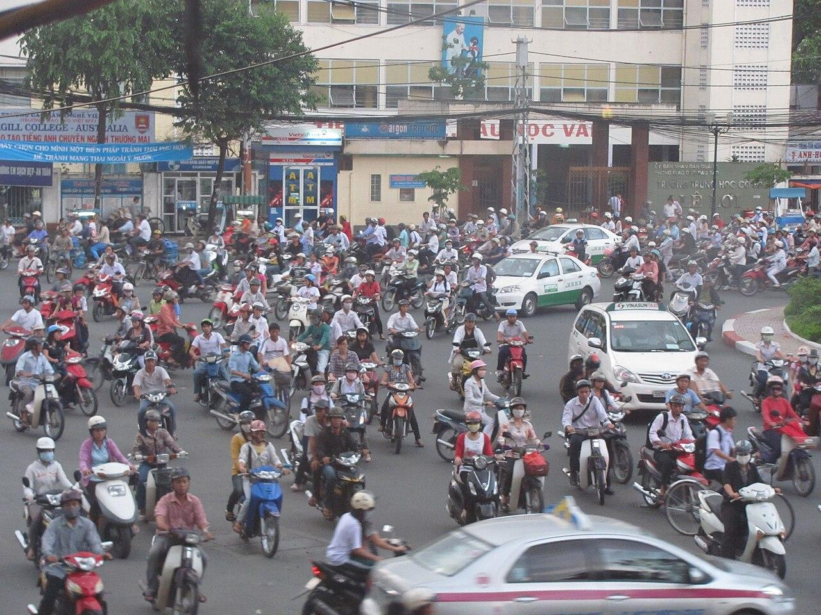

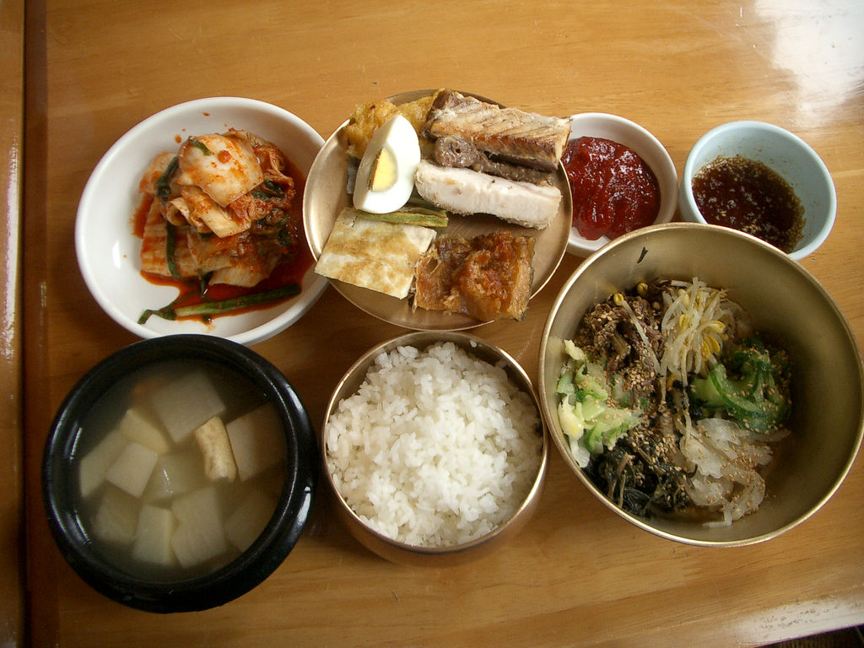
What is culture?
Whatever it is one has to know or believe to operate in a society (Goodenough, 1957)
Relative and changeable in time and space (Fox, 1999)
A way of life, context where people exist, think, feel, and relate to others, the glue binding people together (Brown, 2007)
The National Standards for Foreign Language Learning (1996) depicted culture as a triangle that includes philosophical perspectives, behavioral practices, and tangible and intangible products.

Slide 6
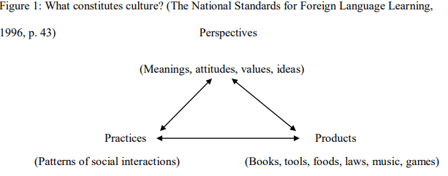

Culture as a triangle

Slide 7
Societal versus individual cultural levels
(Fox, 2001; Hofstede, 2011)
societal level
Individual level

Slide 8


Culture in the age of AI
Cultures affect people’s perspectives about AI and its potential (Ge et al., 2024))
Technology shapes culture (Moxley, 2024)

Slide 9


The CONDUIT metaphors
Thoughts and ideas = object
Language = container
The speaker puts an object (ideas) into a container (language) and gives it to the listener.
Example: “One-on-one meetings have been difficult as my words don’t get through.”

Slide 10

The CONDUIT metaphors
Lakoff & Johnson, 1980, page 11.
It’s hard to get that idea across to him.
I gave you that idea.
Your reason came through to us.
It’s difficult to put my ideas into words.
When you have an idea, try to capture it immediately in words.
Try to pack more thought into fewer words.

Slide 11

Problems with the CONDUIT metaphors
“It’s the least I can do.”

Slide 12


Differences across cultures
Linguistic variation | Concept about time | Social conformity
English: take medicine Vietnamese: drink medicine Chinese: eat medicine | Event-based cultures (late when coming after others) Clock time cultures (late after the starting time) | Uniqueness is valued. Conformity is valued. (Japanese proverb: The nail that sticks out gets hammered down.)

Slide 13

Key concepts in intercultural communication
Communication styles
tone, volume, speed of speech, eye contact, proximity, emotional expressions, self-disclosure, formality, directness, context (high: verbal and non-verbal cues, low: words), orientation to self or others

Slide 14
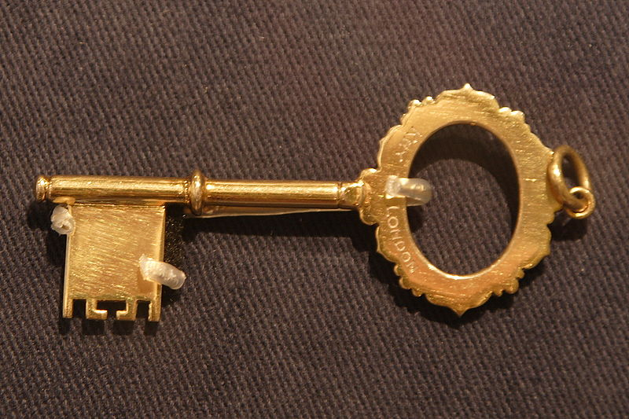

Key concepts in intercultural communication
Enculturation (your own culture)
Acculturation (another culture)
Cultural/cross-cultural awareness
Cultural identity
Culture bump and culture shock

Slide 15
Developmental Model of Intercultural Sensitivity
(Bennet, 1993)
Ethnocentric stages (a person’s own culture is central to reality) | Denial (one’s own culture is the only correct one)
 | Defense (one’s own culture is superior to others which are considered a threat)
Ethnorelative stages (a person’s own culture is seen as one of many possibilities) | Reversal (the new culture is seen as superior to one’s own culture; one is critical of their primary culture)
 | Minimization (cultural differences are considered less important than similarities)
 | Acceptance (one’s own culture is viewed as one among other equally complex cultures)
 | Adaptation (cognitive and behavioral adaptations are employed depending on contexts)
 | Integration (incorporating various cultures into one’s worldview, shifting competently back and forth across cultures)

Slide 16
6 cultural dimensions (Hofstede, 2011)
Small power distance (children are treated equals) | Large power distance (children are should be obedient)
Uncertainty acceptance | Uncertainty avoidance
Collectivism (focus on “we”) | Individualism (focus on “I”)
Masculinity (gender roles are great) | Femininity (gender roles are minimal)
Short-term orientation (US, Australia …) | Long-term orientation (East Asian, Eastern & Central Europe)
Indulgence(freedom of speech is important) | Restraint (freedom of speech is not a primary concern)

Slide 17
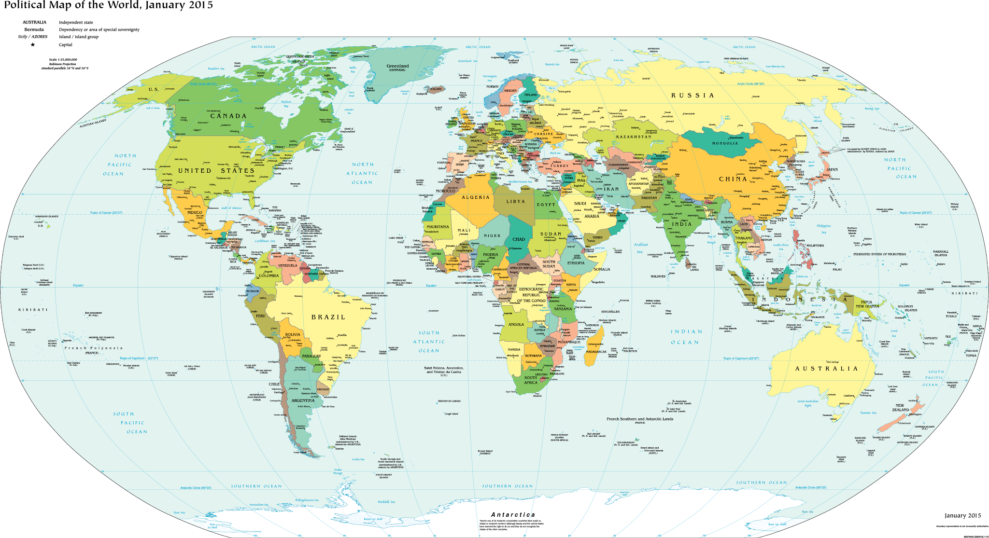
Cultural humility (Guskin, 2013)
Questioning the supremacy of our culture and understanding the validity of another’s culture puts us in a learning mode.
Instead of assuming our comprehension of another culture, we ask questions to clarify what is meant.
We need to respect the fact that misunderstanding and miscommunication is possible.

Slide 18
Striving for excellence in intercultural communication
Author
curiosity
suspension of judgment
cognitive flexibility
cultural humility
tolerance of ambiguity
(Bennet, 2009)
Audience
different knowledge
assumptions
values
culture
(Lakoff & Johnson, 1980)
text
setting
author
purpose
audience

Slide 19
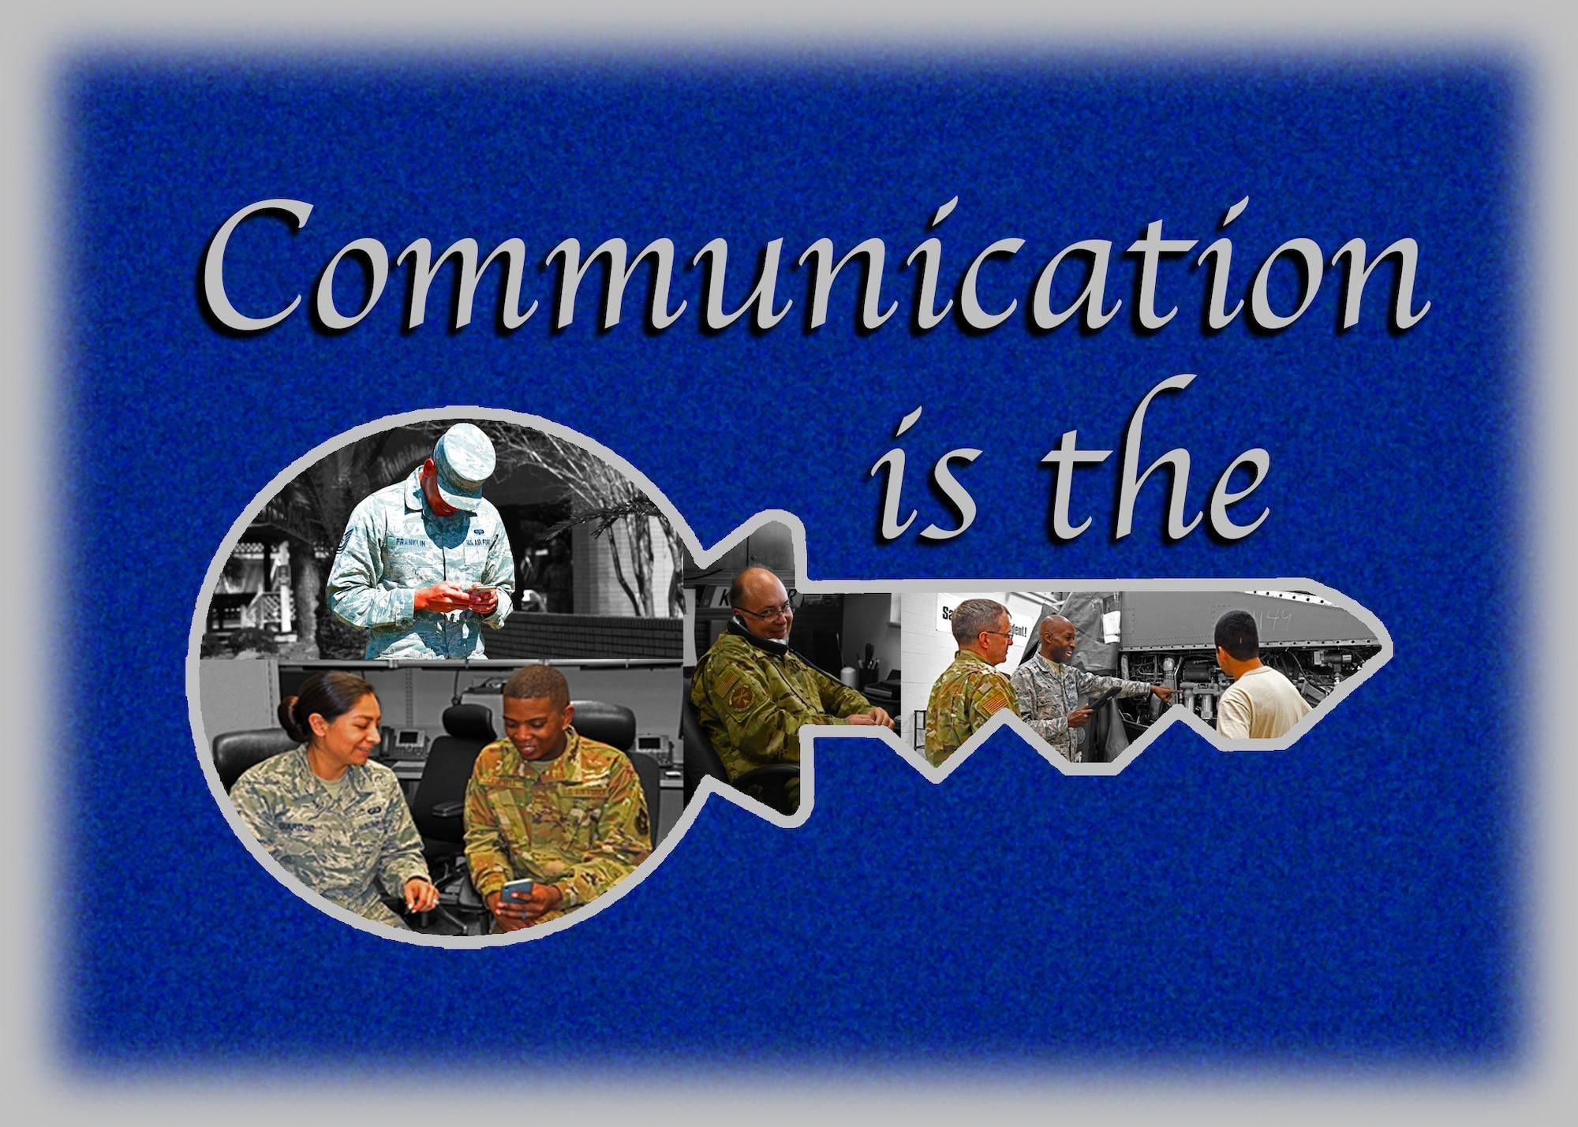
Common expectations for effective communication
(King & Bailey, 2021; Bullock & Sanchez, 2021, Emerson, 2021)
Speak slowly and enunciate
Eliminate cultural references
Avoid idioms and abbreviations
Pay attention to non-verbal cues
Watch your tone
Practice active listening

Slide 20
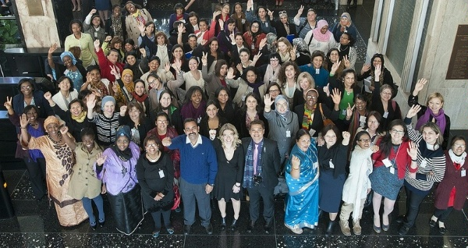
Fostering effective intercultural communication
Based on Deardoff (2008)
Attitudes
Knowledge
Skills

Slide 21
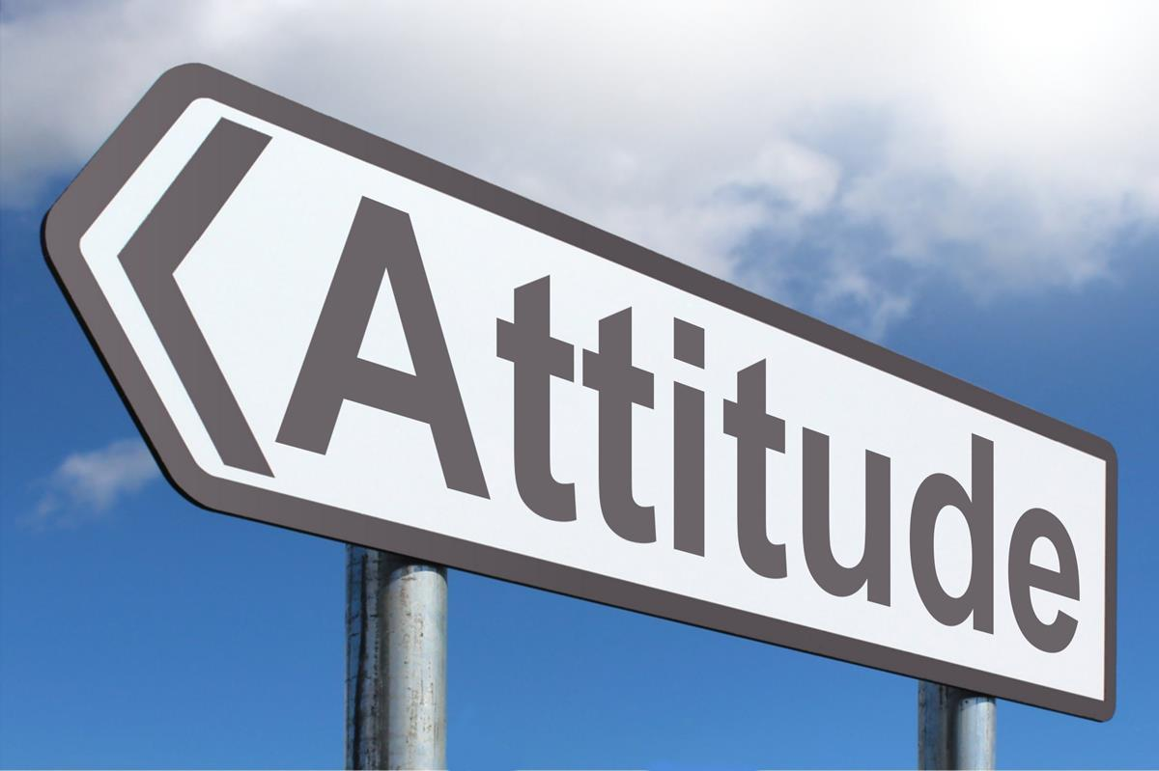
Attitudes
Bring the attitudes of respect, openness, humility, and curiosity to the conversation with other people.

Slide 22
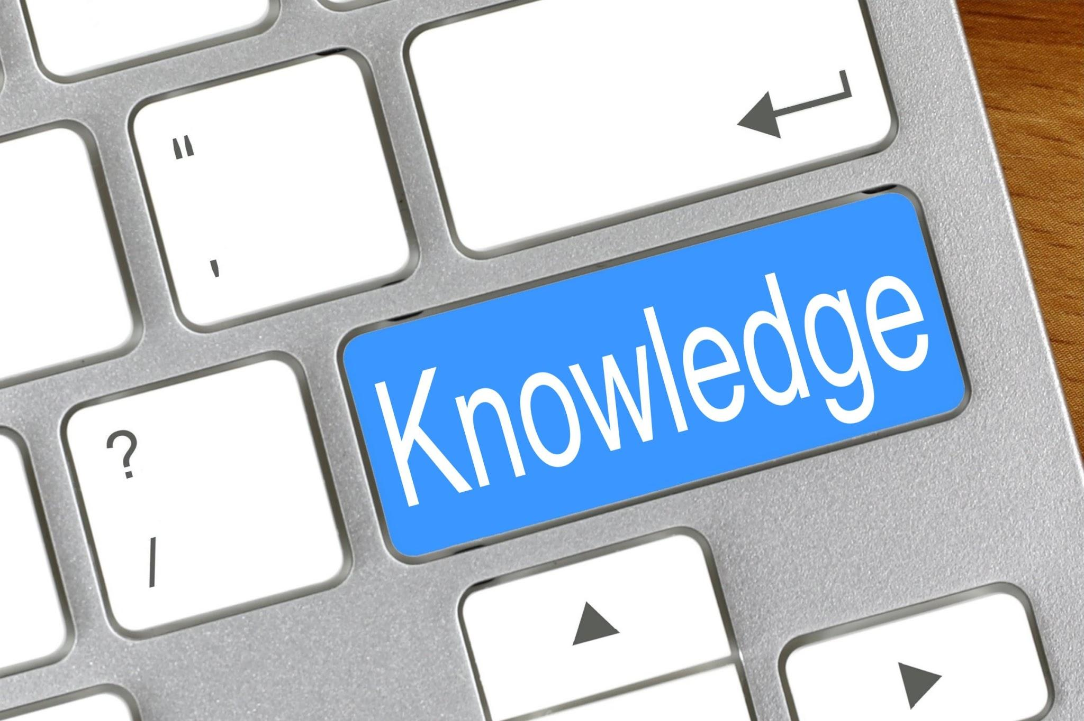
Knowledge
Acquire fundamental knowledge of intercultural communication to communicate across cultures with confidence and humility.
elements of culture
enculturation
acculturation
cultural or cross-cultural awareness
cultural identity
culture bump
culture shock
cultural dimensions
Intercultural communication through the lens of constructivism
cultural humility, elements of intercultural competence

Slide 23

Skills
Sharpen intercultural communication skills via
Practicing active listening
Employing linguistic brevity and clarity (simple, short words, sentences, and questions; limited use of abbreviations, jargons, and idiomatic expressions)
Putting an emphasis on comprehension (summarizing key points to ensure interlocutors fully understand them and prompting interlocutors to relay the message received to ensure accuracy of the massage)
Embracing exploration and explanation of cultural differences

Slide 24

Fostering effective intercultural communication
Recap
Bring the attitudes of respect, openness, and curiosity to the conversation with people of diverse backgrounds.
Acquire fundamental knowledge of intercultural communication to communicate across cultures with confidence and humility.
Sharpen intercultural communication skills via active listening, linguistic brevity and clarity (simple, short words, sentences, and questions; limited use of abbreviations, jargons, and idiomatic expressions), emphasis on comprehension (summarizing key points to ensure interlocutors fully understand them and prompting interlocutors to relay the message received to ensure accuracy of the massage), exploration and explanation of cultural differences.

Slide 25
References
Allen, S. (2018). Creative diversity: promoting interculturality in Australian pathways to higher education. Journal of International Students, 8(1), 251-273.
Altarriba, J., & Basnight-Brown, D. (2022). The Psychology of Communication: The Interplay Between Language and Culture Through Time. Journal of Cross-Cultural Psychology, 53(7-8), 860-874. https://doi.org/10.1177/00220221221114046
Arends, R. I. (1998). Resource handbook. Learning to teach (4th ed.). Boston, MA: McGraw-Hill.
Bennet, M. J. (1993). Towards ethnorelativism: A developmental model of intercultural sensitivity. In R. M. Paige (Ed.), Education for the intercultural experiences (pp. 21-71). Yarmouth, ME: Intercultural Press.
Bennet, M. J. (1998). Intercultural communication: A current perspective. In M. J. Bennet (ed.), Basic concepts of intercultural communication: selected readings (pp. 1-34). Yarmouth, ME: Intercultural Press.
Bennet, J. M. (2009). Cultivating intercultural competence. In D. K. Deardorff (Ed), the SAGE handbook of intercultural competence (121-140). Thousand Oaks, CA: Sage publications.
Brown, S., & Eisterhold, J. (2004). Topics in language and culture for teachers. Ann Arbor, MI: University of Michigan Press.
Bullock, D. & Sanchez, R. (2021). What’s the best way to communicate on a global team? Harvard Business Review. Retrieved on February 21, 2024 from What’s the Best Way to Communicate on a Global Team? (hbr.org)

Slide 26
References
Chomsky, N. (1972). Language and mind. Harcourt Brace Jovanovich.
Dewey, J. (1938) Experience and Education. New York: Collier Books.
Deardoff, D. K. (2008). Intercultural competence: A definition, model, implications for education abroad. In V. Savicki (Ed.), Development intercultural competence and transformation: Theory, research, and application in international education (pp.32-52). Sterling, VA: Stylus Publishing.
﻿DuPraw, M. E. & Axner, M. (nd).Toward a More Perfect Union in an Age of Diversity: Working on Common Cross-cultural Communication Challenges. Retrieved on February 29, 2024 from https://www.pbs.org/ampu/crosscult.html#TASKS
Elliott, S.N., Kratochwill, T.R., Littlefield Cook, J. & Travers, J. (2000). Educational psychology: Effective teaching, effective learning (3rd ed.) . Boston, MA: McGraw-Hill College.
Emerson, M. S. ( 2021) 8 ways to improve your communication skills. Retrieved on February 29, 2024 from https://professional.dce.harvard.edu/blog/8-ways-you-can-improve-your-communication-skills/
Fox, R. (2001). Constructivism examined. Oxford review of education, 27(1), 23-35.
Ge, X., Xu, C., Misaki, D., Markus, H. R., & Tsai, J. L. (2024, May). How culture shapes what people want from AI. In Proceedings of the 2024 CHI Conference on Human Factors in Computing Systems (pp. 1-15).
Geary, D. (2016). How do we get people to interact? International students and the American experience. Journal of International Students, 6(2), 527-541.
Gusking, A. (2013). On cultural humility. Paper for Encyclopedia of Intercultural Competence Retreived on February 20, 2024 from https://static1.squarespace.com/static/58c476372994cae7ec689bb5/t/5a4430500d9297c68875a6a3/1514418261311/_Final+Draft+on+Cultural+Humility+for+Encyclopedia+of+Intercultural+Competence.pdf
Hofstede, G. (2011). Dimensionalizing Cultures: The Hofstede model in context. Online Readings in Psychology and Culture, 2(1). https://doi.org/10.9707/2307-0919.1014
King, C. S. J. & Bailey, K. S. (2021). Intercultural communication and US higher education: How Us students and faculty can improve international students’ classroom experiences. International Journal of International Relations, 82, 278-287.

Slide 27
References
Lakoff, G. & Johnson, M. (1980). Metaphors we live by. Chicago, IL: The University of Chicago Press.
McLeod, S. (2024). Constructivism as a theory for teaching and learning. Simplypsychology.org
Open Door 2023 Report on International Educational Exchange Retrieved on February 29, 2024 from https://opendoorsdata.org/annual-release/international-students/
Paige, R. M. (1993). On the nature of intercultural experiences and intercultural education. In R. M. Paige (Ed.), Education for the intercultural experiences (pp. 169-199). Yarmouth, ME: Intercultural Press.
Paige, R. M. (2006). Dimensions of intercultural learning. In R. M. Paige, A. D. Cohen, B. Kappler, J. C. Chi & J. P. Lassegard (Eds.), Maximizing study abroad: a student’s guide to strategies for language and culture learning and use (pp. 40-41. Minneapolis: Center for Advanced Research on Language Acquisition: University of Minnesota.
Paige, R. M, Cohen, A.D., & Shively R. L. (2004). Assessing the impact of a strategies-based curriculum on language and culture learning abroad. Frontiers: The Interdisciplinary Journal of Studying Abroad, 10, 253-276.
Paige, R. M. & Goode, M. L. (2009). Intercultural competence in intercultural education administration: Cultural mentoring. In D. K Deardoff (Ed.), The SAGE handbook of intercultural competence (pp. 333-349). Thousand Oaks, CA: Sage publications.
Pederson, E. (1995). Language as context, language as means: spatial cognition and habitual language use. Cognitive Linguistics, 6, 33-62.
Pinker, S. (1994). The language instinct. New York, NY: Harper Perennial Modern Classics.
Phillips, D. C. (1995). The good, the bad, and the ugly: The many faces of constructivism. Educational researcher, 24 (7), 5-12.
Rogers, C. R. & Farson, R. E. (1987). Active listening. Excerpt from Communicating in Business Today R.G. Newman, M.A. Danzinger, M. Cohen (eds) D.C. Heath & Company. Retrieved on February 28, 2024 from https://wholebeinginstitute.com/wp-content/uploads/Rogers_Farson_Active-Listening.pdf
Sherry, M., Thomas, P., & Chui, W. H. (2010). International students: A vulnerable student population. Higher Education, 6, 33-46. International students: a vulnerable student population | Higher Education (springer.com)

Slide 28
References
Stivers, T., Enfield, N. J., Brown, P., Englert, C., Hayashi, M., Heinemann, T., Hoymann, G., Rossano, F., de Ruiter, J. P., Yoon, K. E., & Levinson, S. C. (2009). Universals and cultural variation in turn-taking in conversation. Proceedings of the National Academy of Sciences of the United States of America, 106(26), 10587–10592. https://doi.org/10.1073/pnas.0903616106
Tran, T. H (2010). Teaching Culture in the EFL/ESL Classroom. ERIC Document number ED11819
The US Department of Health and Human Services (nd.) Think cultural health: Communication styles. Retrieved on February 29, 2024 from https://thinkculturalhealth.hhs.gov/assets/pdfs/resource-library/communication-styles.pdf
UC San Diego: International Students & Program Office: Tips for effective intercultural communication with culturally diverse students. Retrieved on February 29, 2024 from https://ispo.ucsd.edu/_files/campus-partners/Effective-Intercultural-Communication.pdf
University of Denver: Office of Teaching and Learning (nd.) Cross cultural communication tips. Retrieved on February 29, 2024 from https://otl.du.edu/plan-a-course/teaching-resources/cross-cultural-communication-tips/
van Eerde, W., & Azar, S. (2020). Too Late? What Do You Mean? Cultural Norms Regarding Lateness for Meetings and Appointments. Cross-Cultural Research, 54(2-3), 111-129. https://doi.org/10.1177/1069397119866132
Vande Ber, M. & Paige, R. M. (2009). Applying theory and research: The evolution of intercultural competence of U.S. study abroad. In D. K Deardoff (Ed.), The SAGE handbook of intercultural competence (pp. 333-349). Thousand Oaks, CA: Sage publications.
Vygotsky, L. S. (1978). Mind in society: The development of higher psychological processes. Cambridge, MA: Harvard University Press.
Wardhaugh, R. (2010). An introduction to sociolinguistics. Malden, MA: Wiley-Blackwell.
Washington University School of Medicine in Saint Louis (nd.) Office of diversity, equity & inclusion: Communicating across cultures. Retrieved on February 29, 2024 from
https://diversity.med.wustl.edu/resources/strategies-for-effective-communication-across-cultures/
Zhou, Y., Jindal-Snape, D., Topping, K. & Todman, J. (2008). Theoretical models of culture shock and adaptation in international students in higher education, Studies in Higher Education, 33:1, 63-75, DOI: 10.1080/03075070701794833

